Slide 1
Monte Carlo Simulation of Ionization rates by electrons in the ionosphere -Proof of concept
Armando Maldonado

Slide 2
Outline
Background & review
Set-up
Results & comparison
Discussion and improvements

Slide 3
Background & Review
Monte Carlo – Simulation based on random number generation
A more “natural” approach to physics problems that rely on stochastic methods.
High simulation times
Ionization in the atmosphere by electrons (Solomon 1993)
One processes that cause ionization (Chapman production & ions)
Problem results in “cascade” effect where secondary, ionized electrons have fates

Slide 4
Set-up - Assumptions
No magnetic field for simplicity. (simply drop the electron)
No wave-field effects
Particle type does not matter (or mass/charge)
Seed populations, and future generations and atmospheric structure do not produce cumulative effects

Slide 5


Set-up - Parameters
Atmosphere is an undefined monoatomic neutral gas whose density increases exponentially with decreasing altitude h defined by a constant scale height, H.
The probability P(A) of interaction scales linearly with the density of particles and therefore.

Slide 6
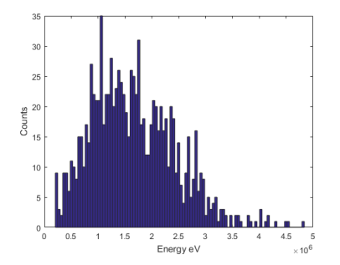

Set-up - Parameters
Initial energy is Maxwellian distribution simulated with random numbers. Center energy is 2keV = E0

Slide 7
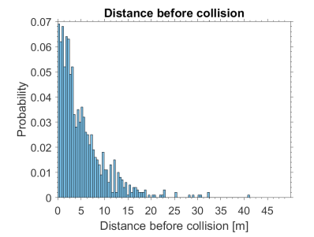
Set-up Distance before collision
Particle falls from 600 km
is a characteristic mean free path
Set to 5 meters

Slide 8
Electron falls random distance
Yes
E>25 eV?
No
Yes
Height > 0?
No
Stop
Yes
Random collision type
Ionize
Elastic
Create new particle with energy En
Excitation
Original electron loses energy

Slide 9
Set-up - Collisions
Elastically collide - no energy lost, it continues to fall towards Earth)
Excite or Dissociate - no net particle created but energy is lost and it continues to fall
Ionize - a particle is created, energy is lost, and now both fall to continue the same process

Slide 10
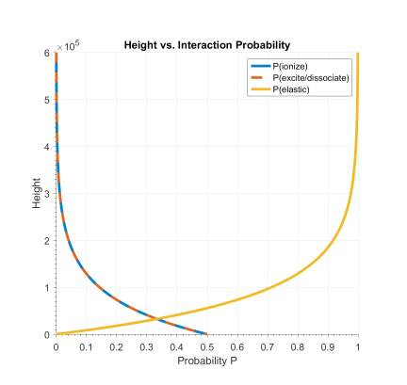
Probabilities
Ionization and Excitation/dissociation probabilities scale such that:
Elastic Collision is simply:

Slide 11
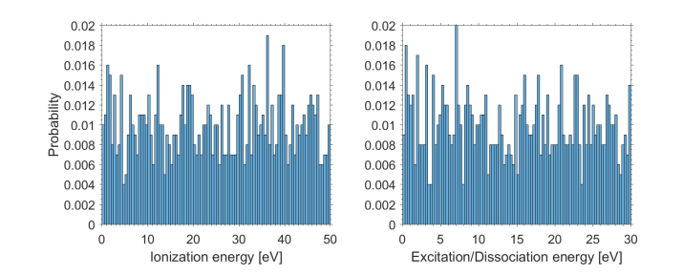
Set-up – Energy loss
Ionization
Uniform random number between 0 to 50 eV
Excitation/dissociation
Uniform random number between 0 and 30 eV

Slide 12
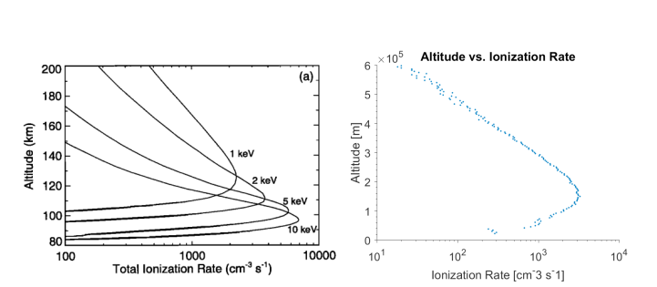
Results

Slide 13
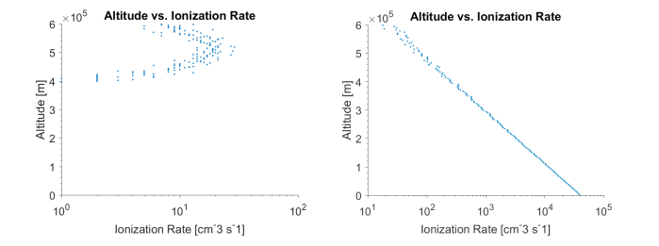
Discussion
Scale is completely off. Could be fixed by inserting more physical parameters such as variable scale height and variable mean free path.
Results are more unstable than physical process. Change center Maxwell energy to 1 keV or 3 keV.
1 keV
3 keV

Slide 14
Conclusion
Monte Carlo in addition to basic physical assumptions provides powerful results
More specific assumptions must be made before drawing quantitative conclusions.

